Slide 1
Overview about APEVN MANAGEMENT SYSTEM
MR. NGUYEN TRI HUY Founder & CEO - SwEETSOFT SOLUTIONS
MR. NGUYEN MINH DUC SOFTWARE TEAM LEADER - SWEETSOFT SOLUTIONS

Slide 2
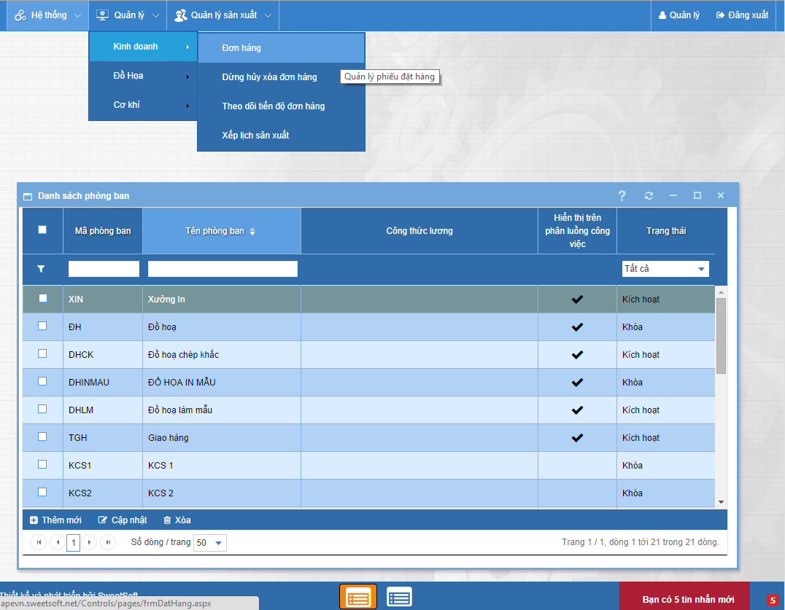
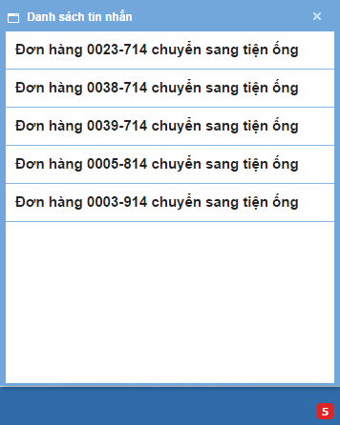
SYSTEM HIGHLIGHT
User-friendly, “windows in browser” GUI.
Support system notification.
Language transparent (able to translate into different languages)

Slide 3
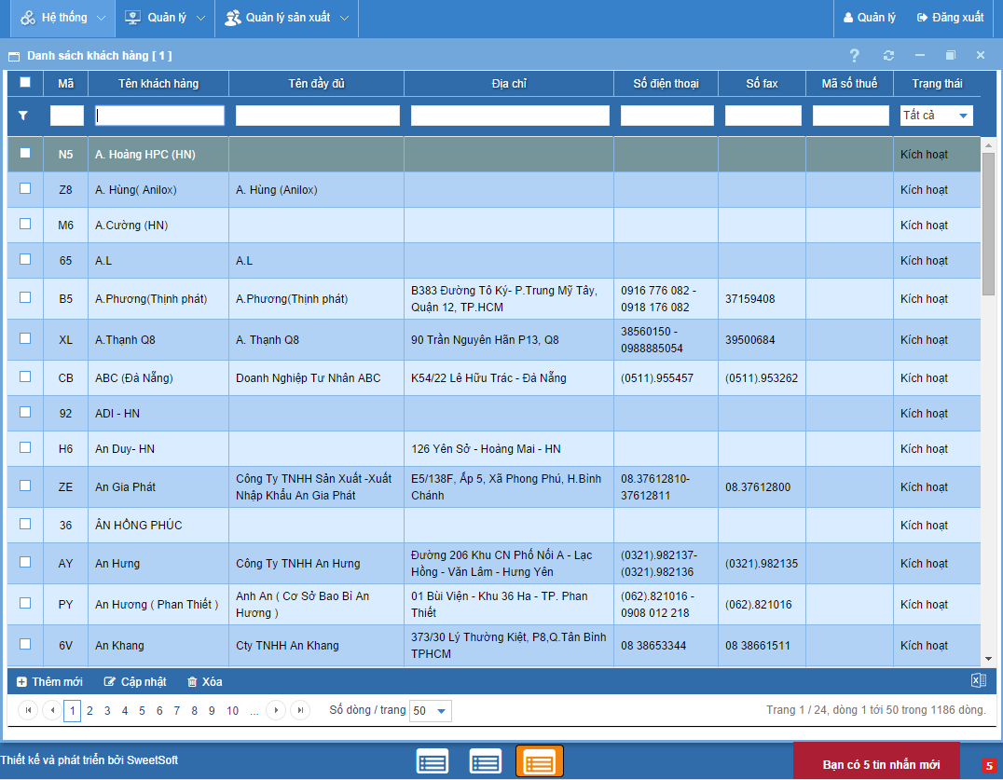
SYSTEM HIGHLIGHT
Flexible list of data: department, staff/worker, task, customer, standard price, printing profile…

Slide 4
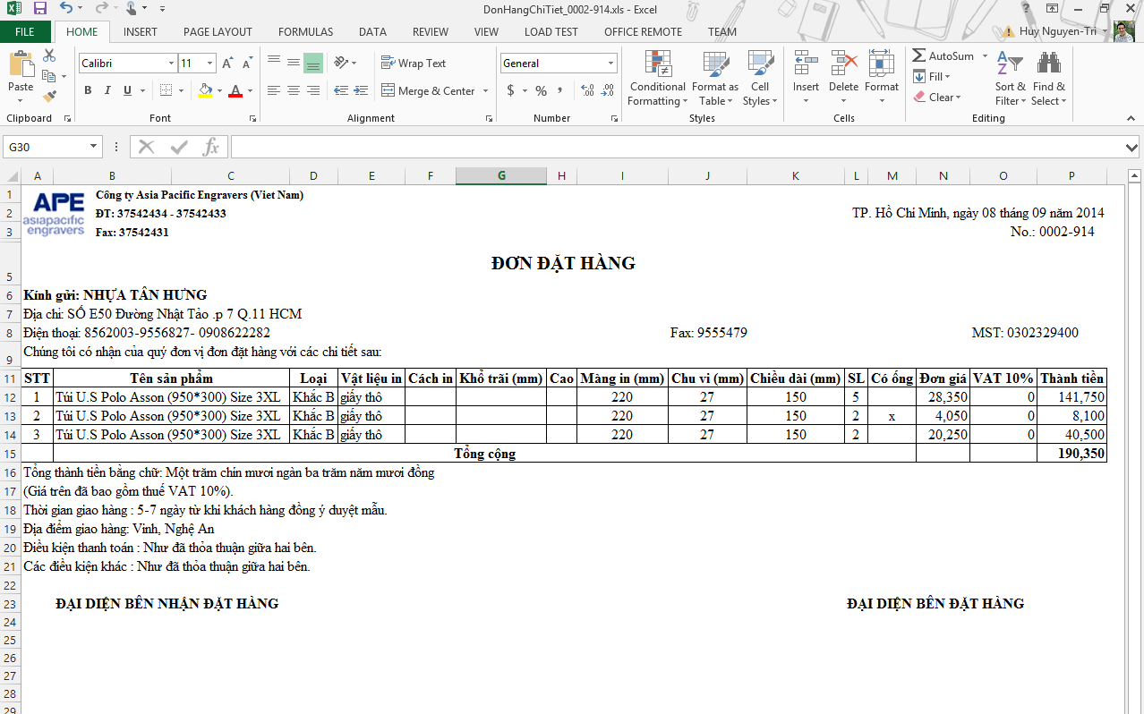
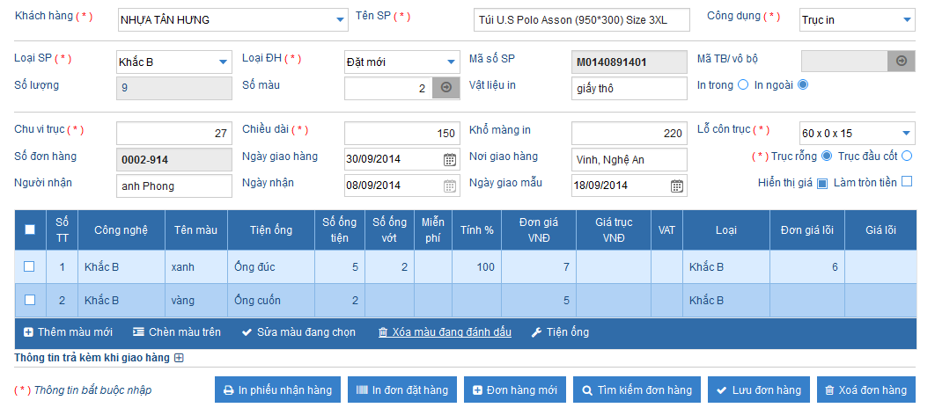
SYSTEM HIGHLIGHT
Order management: input, search, export order to Excel.
Order status: stop/cancel/restore/delete
Cylinder producing status: stop/restore.

Slide 5
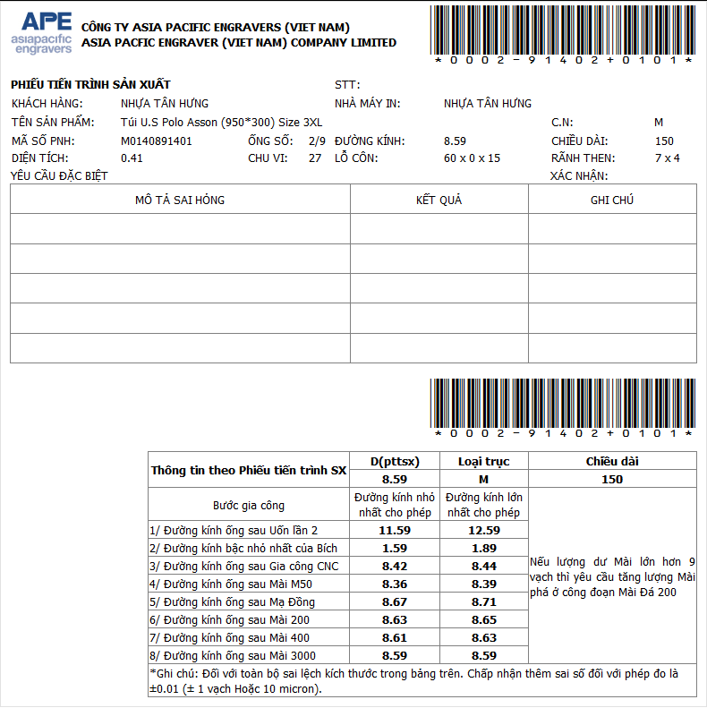
SYSTEM HIGHLIGHT
Print with barcode

Slide 6
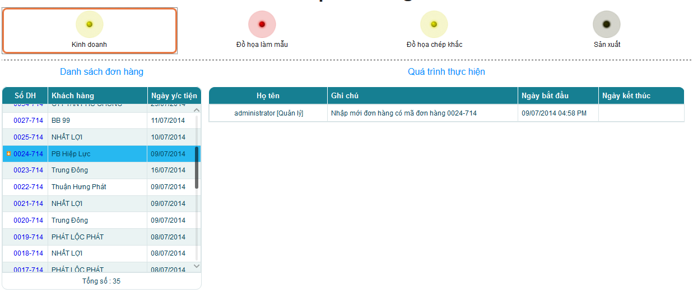
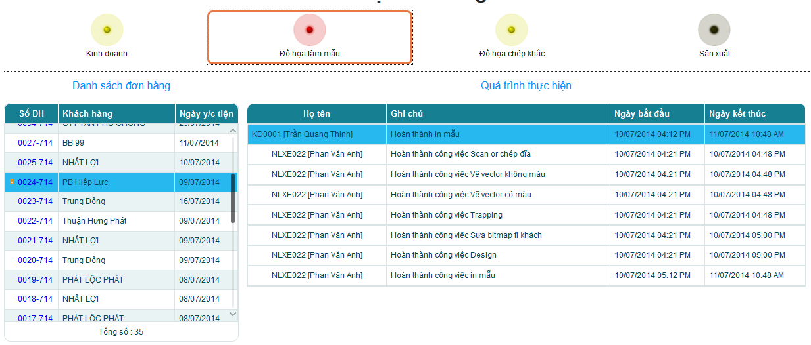
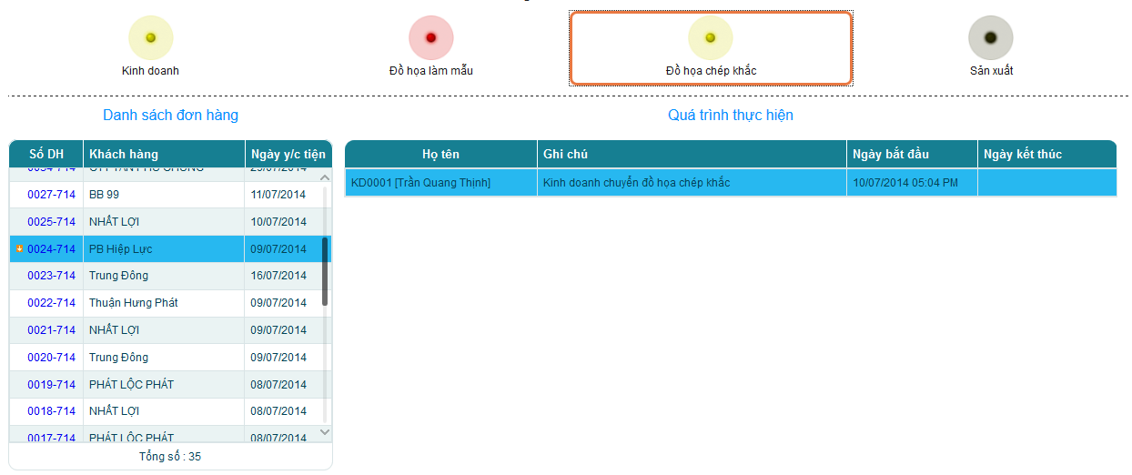
SYSTEM HIGHLIGHT
Support order tracking in timeline interface with user-friendly and stages in detail of order, cylinder.

Slide 7
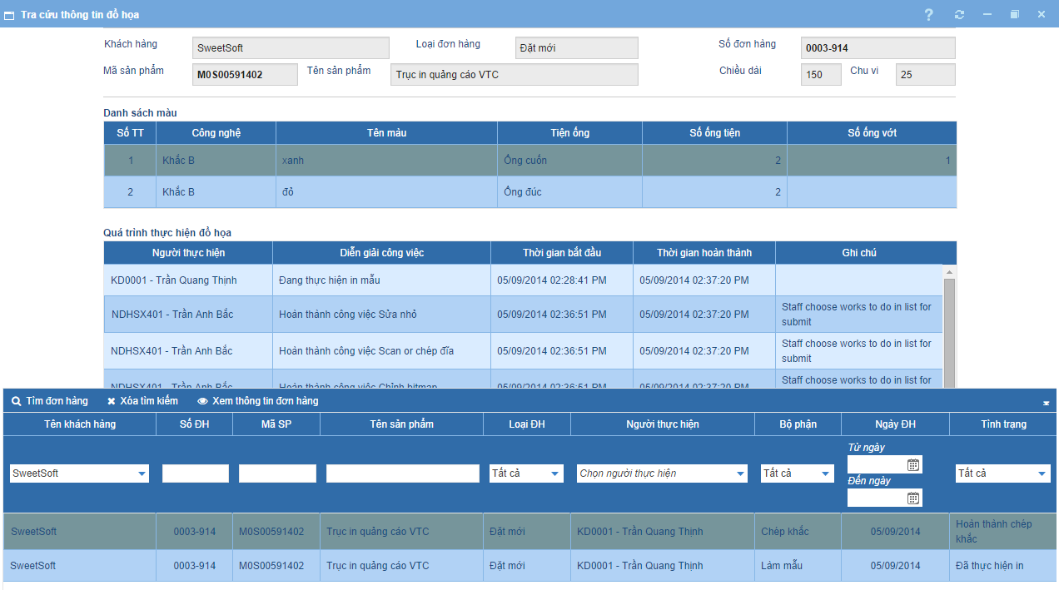
SYSTEM HIGHLIGHT
Look up graphic information: graphic tasks in detail, search for order with graphic task, processes in graphic stage.

Slide 8
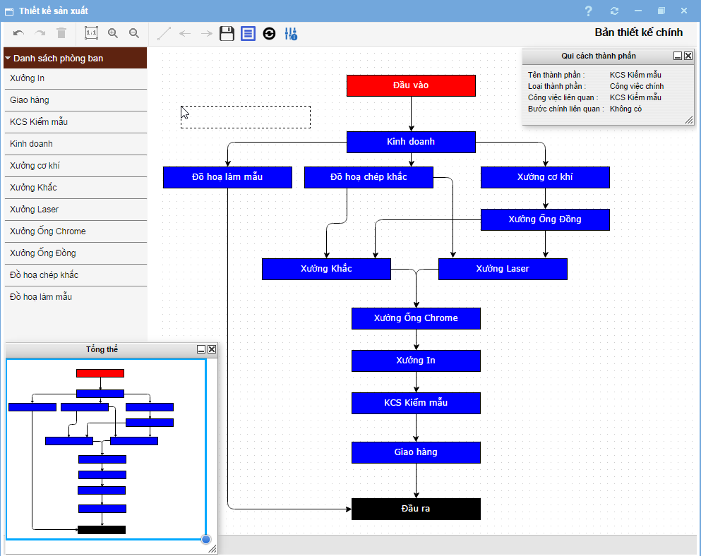
SYSTEM HIGHLIGHT
Workflow designer: drag-and-drop node (connection line, department), support zoom, undo/redo, item properties.

Slide 9
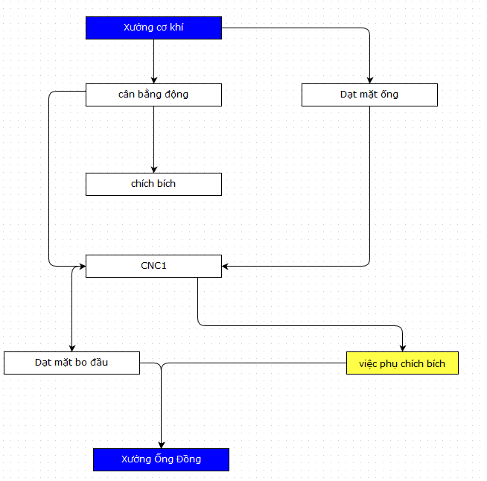
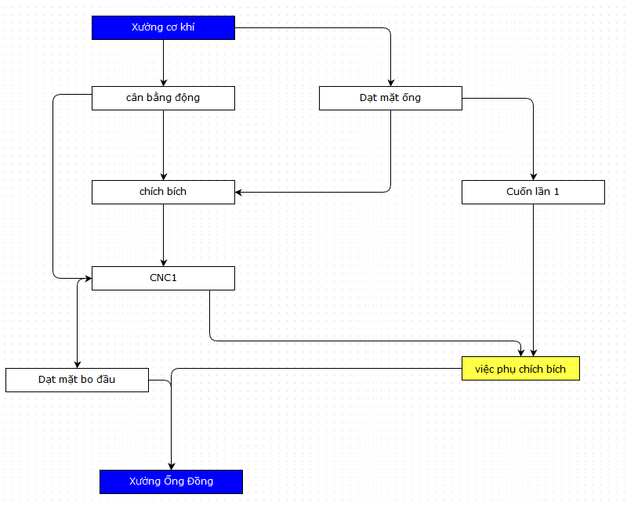
SYSTEM HIGHLIGHT
Workflow designer: drag-and-drop node to change a task

Slide 10
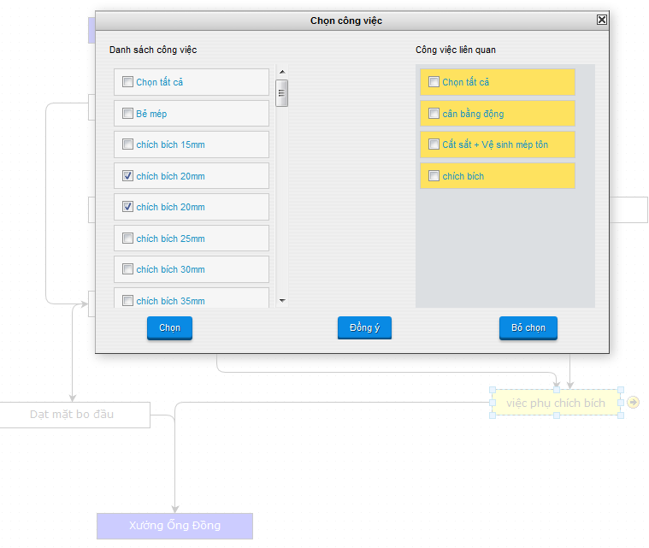
SYSTEM HIGHLIGHT
Workflow designer: sub-task properties

Slide 11
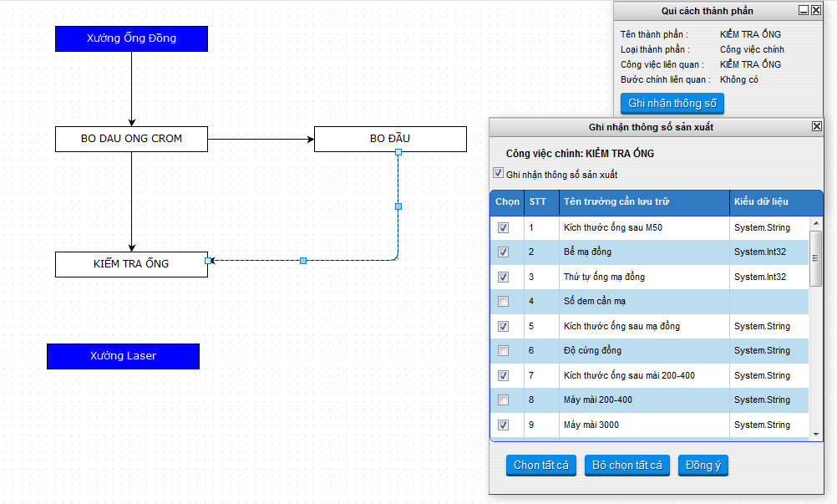
SYSTEM HIGHLIGHT
Workflow designer: Select/View production parameter.

Slide 12
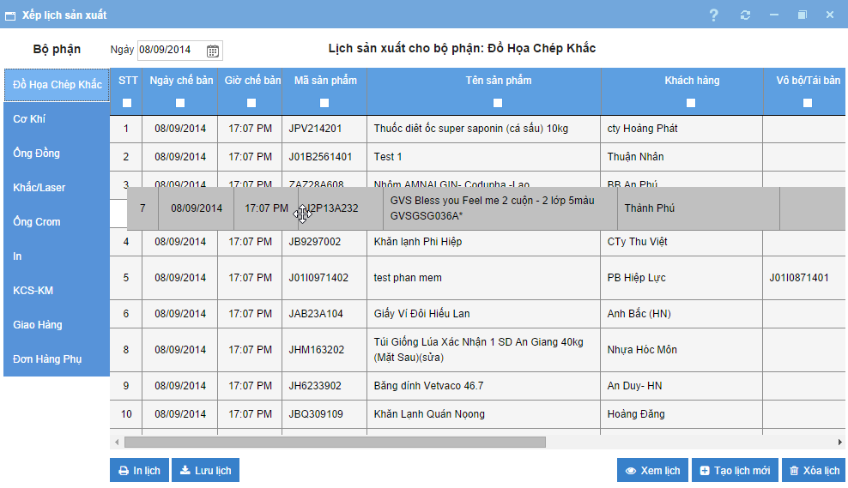
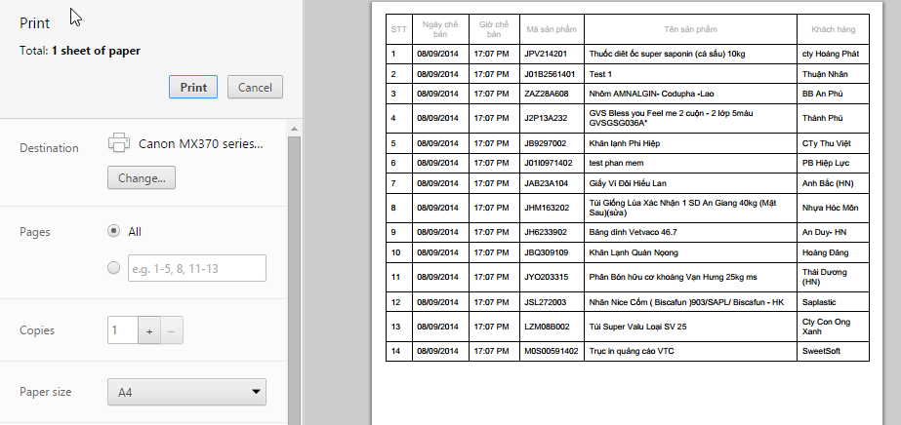
SYSTEM HIGHLIGHT
Production schedule: re-ordering order process at stages by drag-n-drop. Support print schedule at a stage.

Slide 13
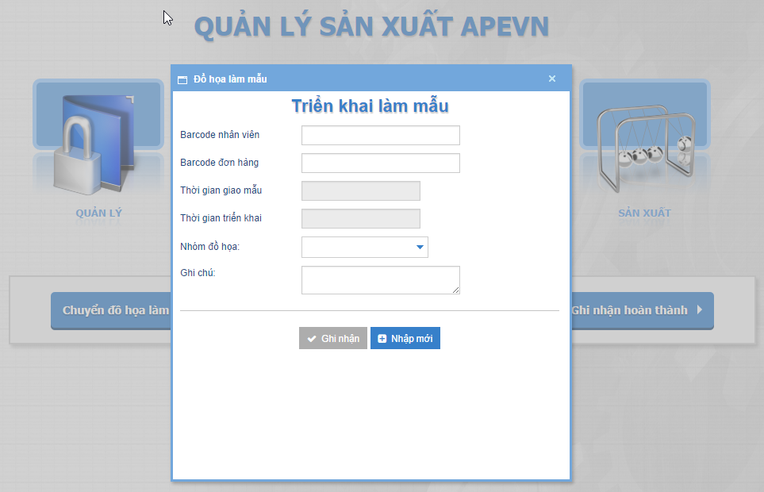
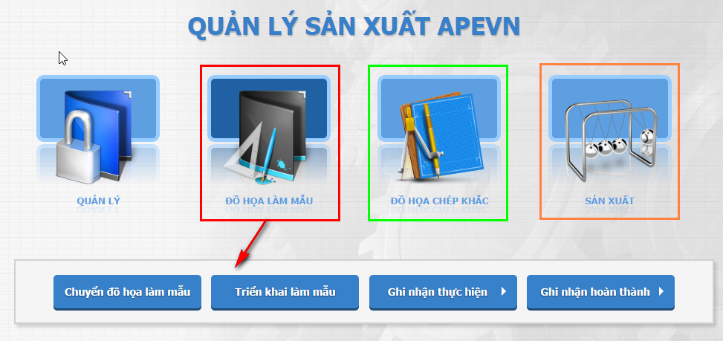
SYSTEM HIGHLIGHT
Production acknowledgment: acknowledge tasks of worker at stage (base on workflow), support scan barcode of order, cylinder, worker.

Slide 14
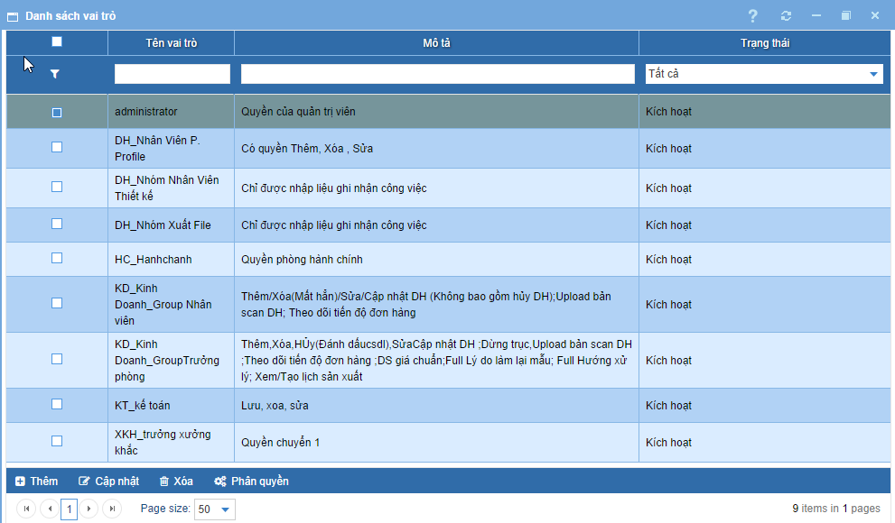
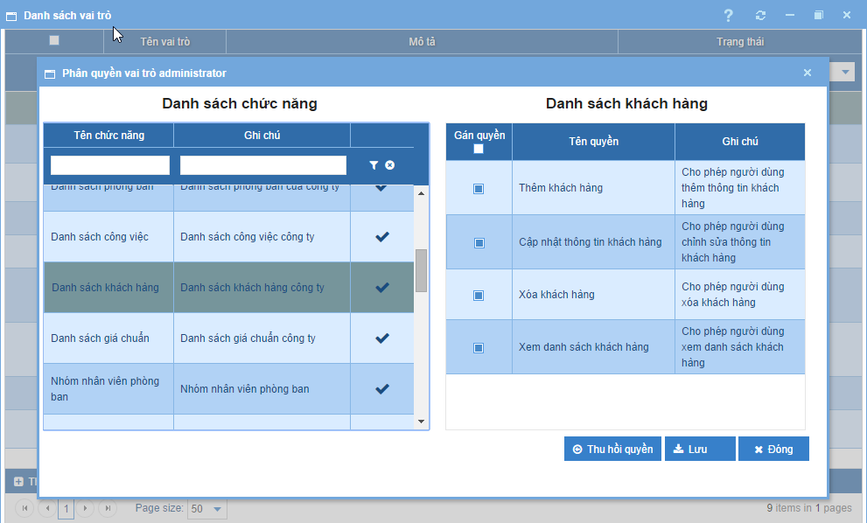
SYSTEM HIGHLIGHT
Flexible system permission base on role and action per function.

Slide 15
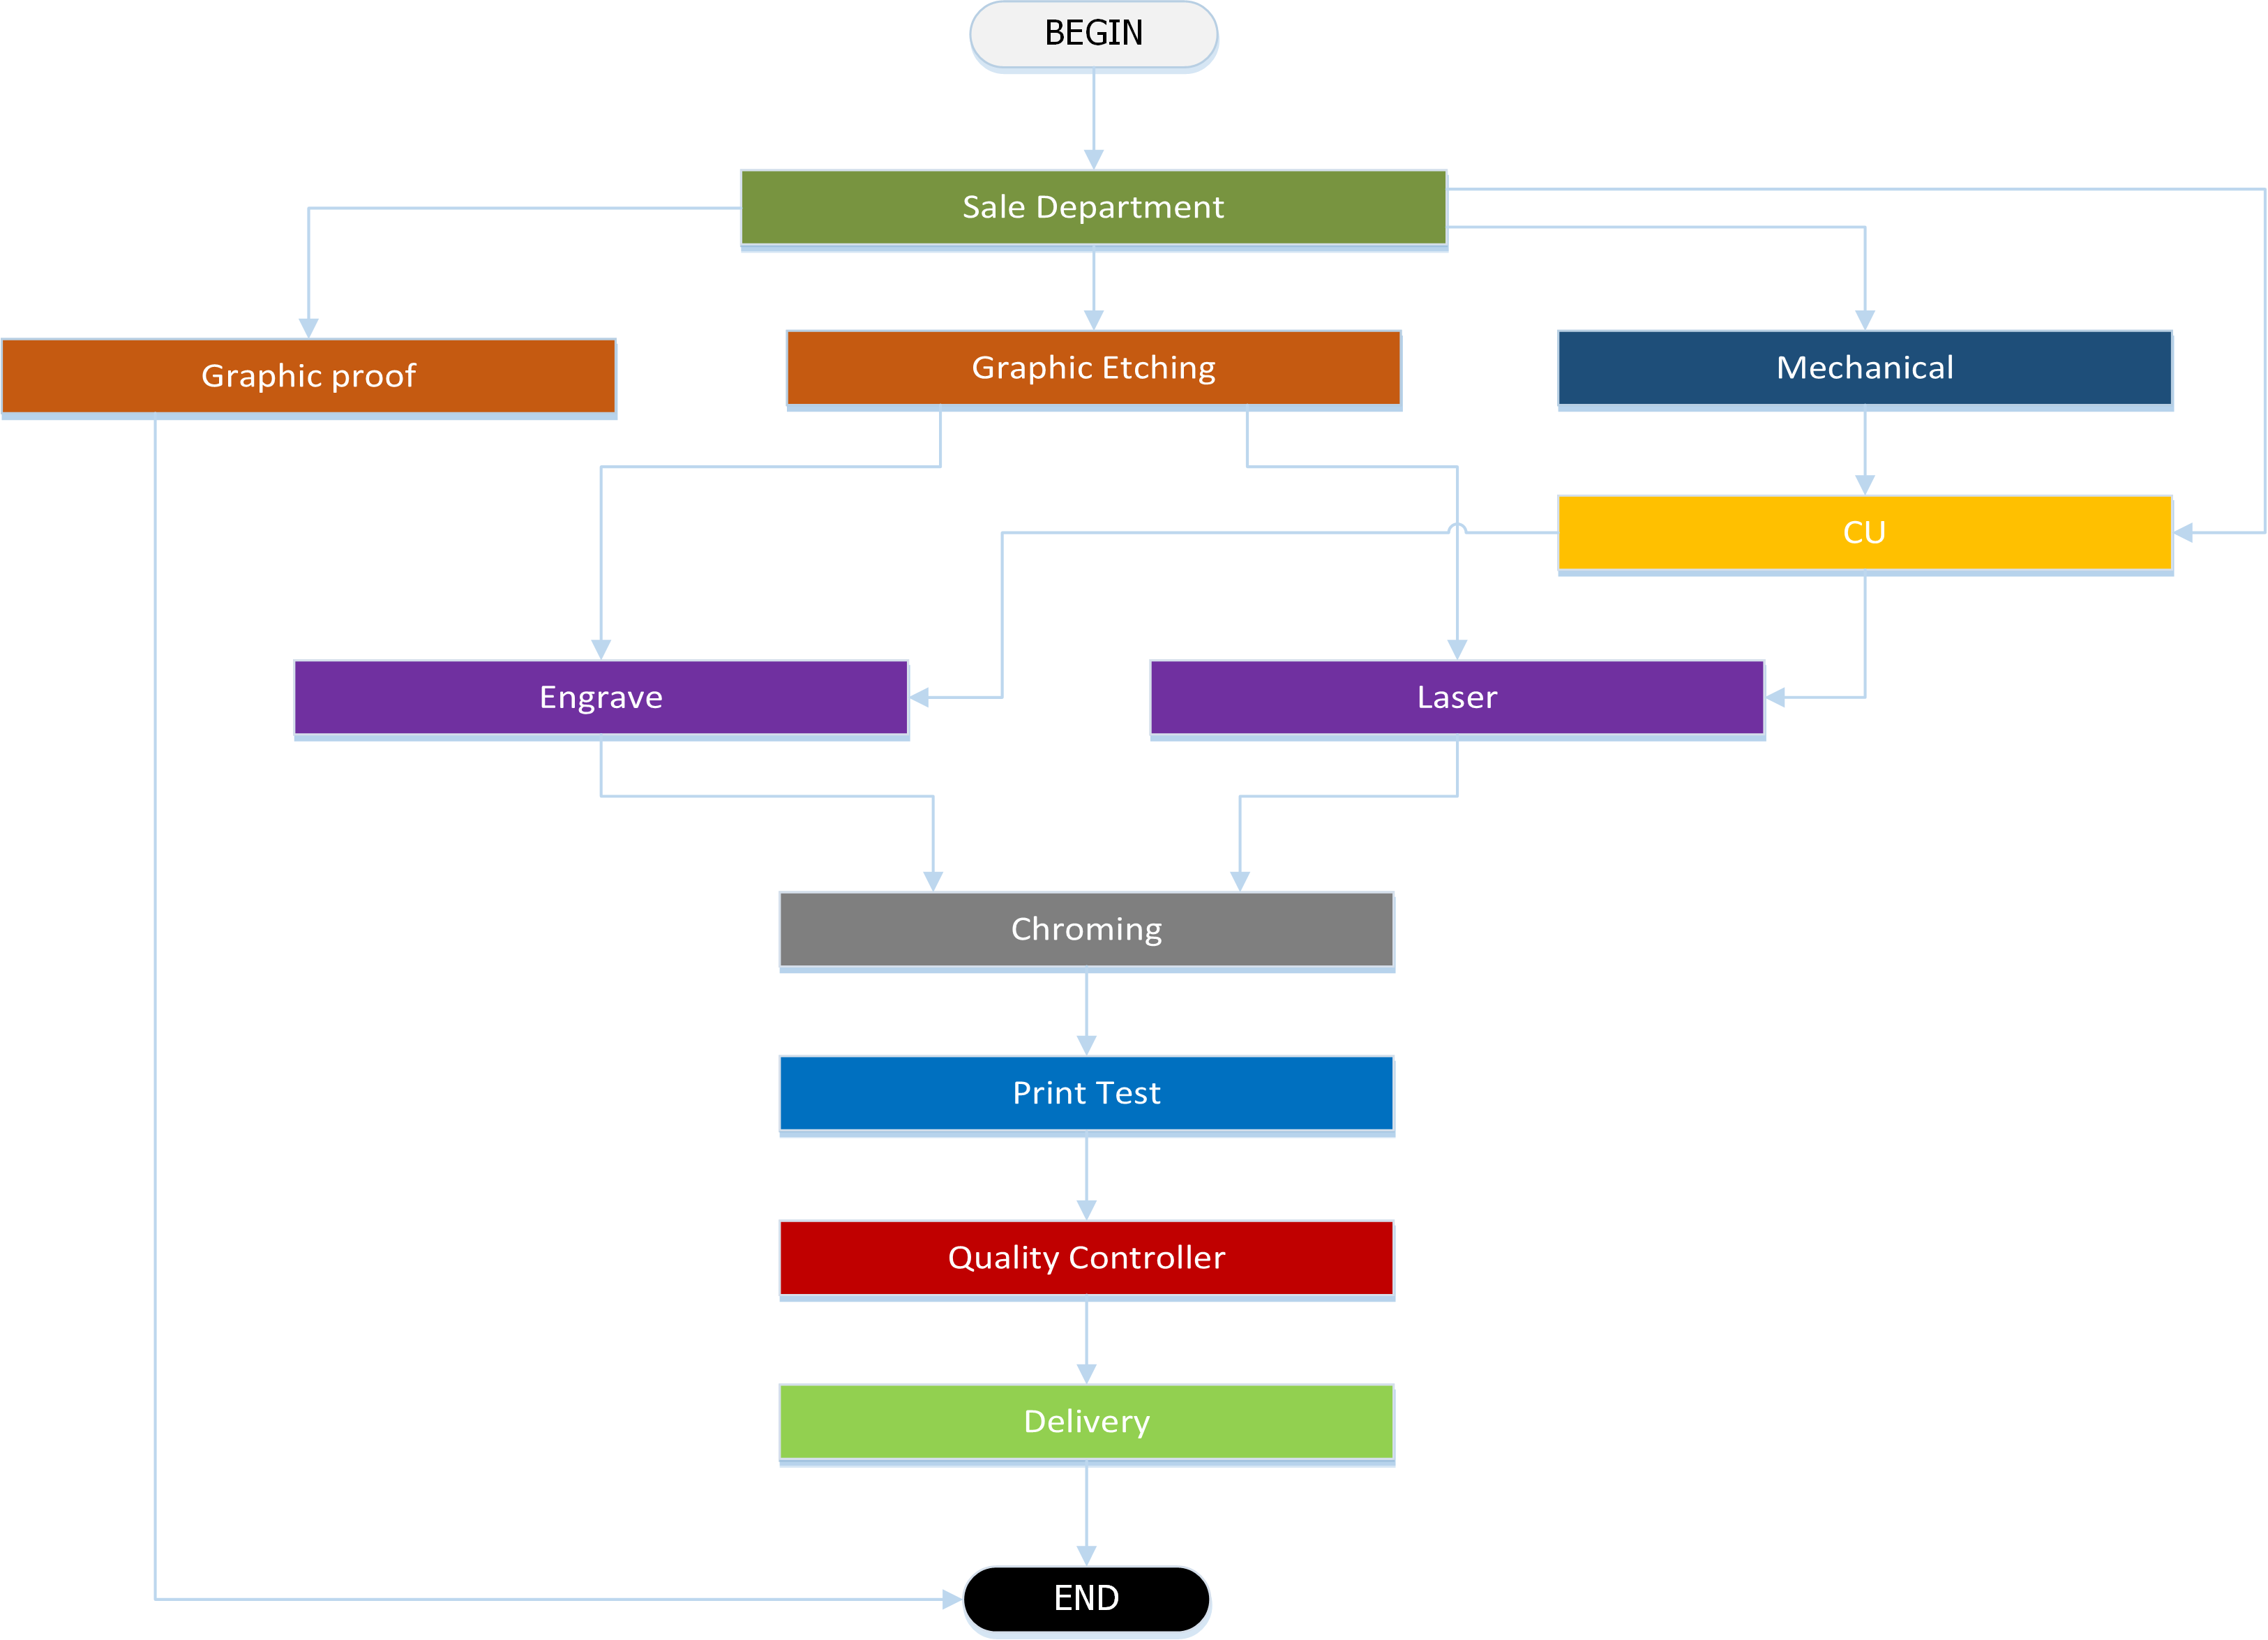
A WORKFLOW BASED SYSTEM

Slide 16
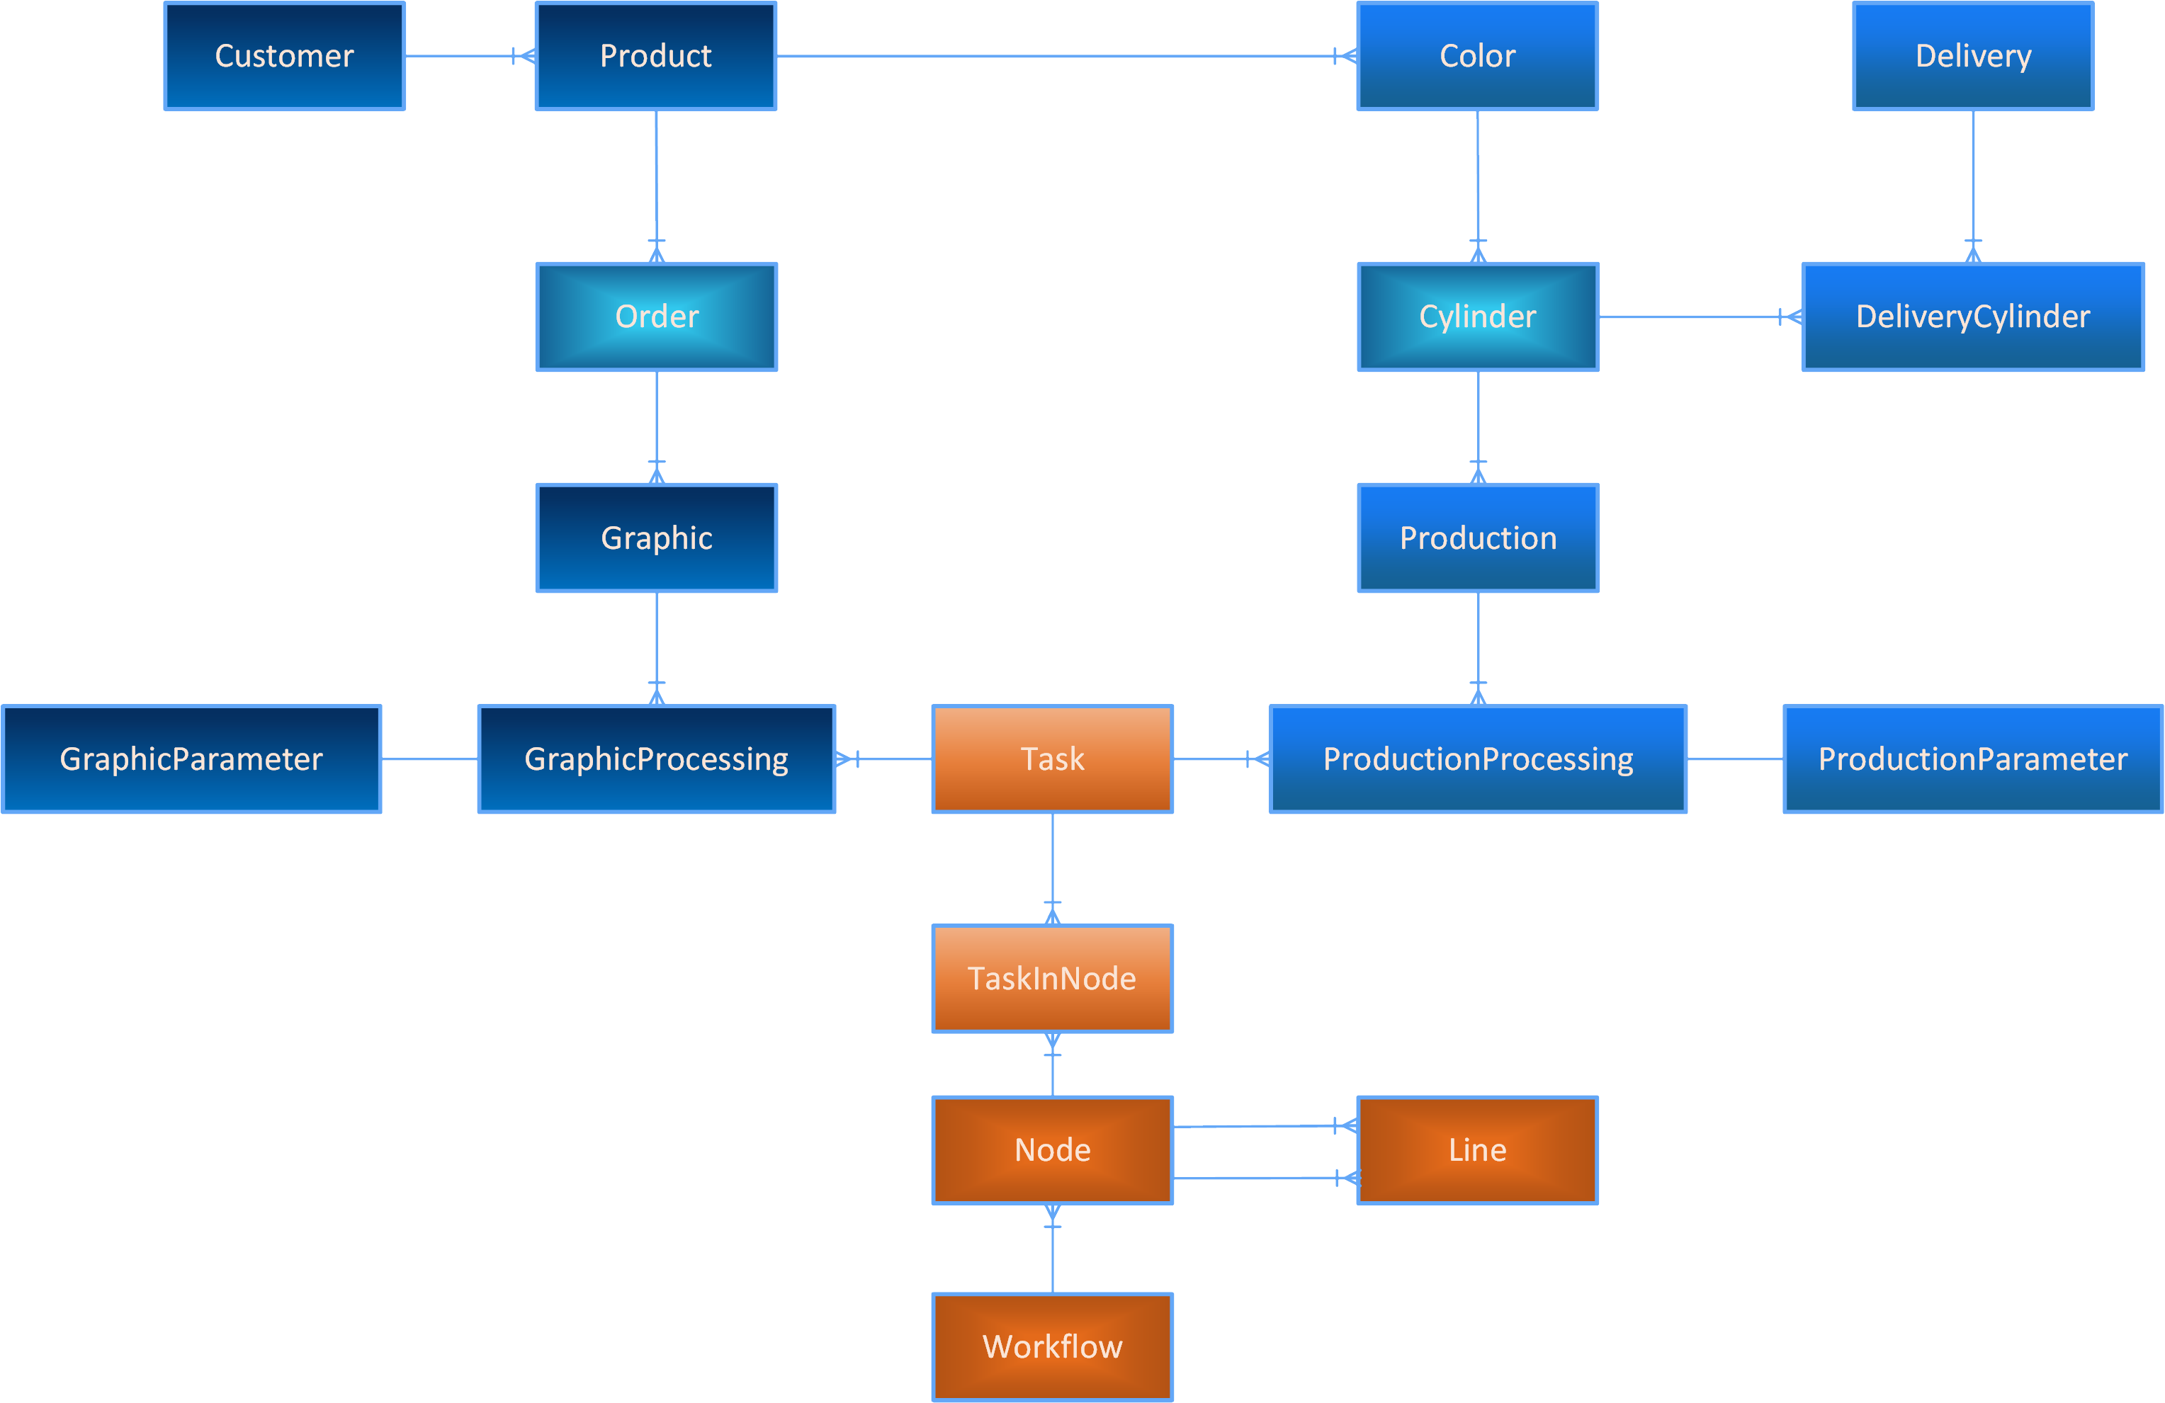
System OBJECT design

Slide 17
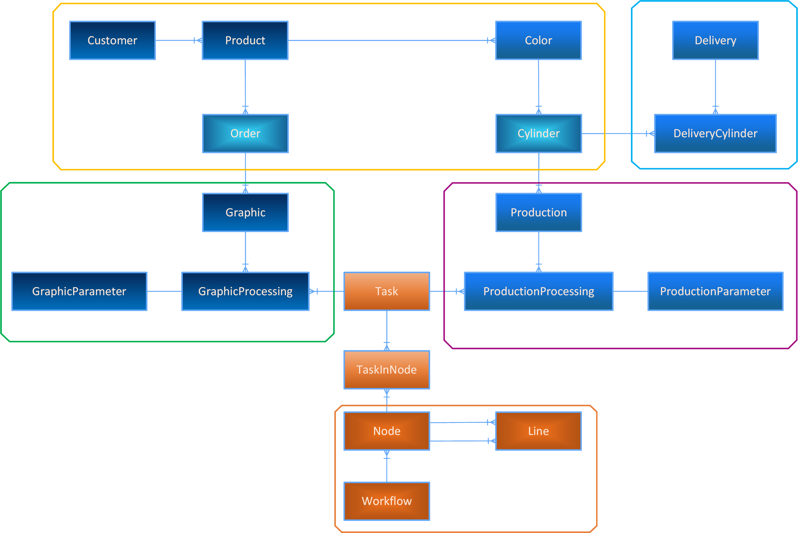
System OBJECT design
Shipment Dept.
Sale Dept.
Graphical Dept.
Product Dept.
Workflow controller

Slide 18
SOFTWARE &
HARDWARE REQUIREMENT
SERVER SIDE
Operating system: Windows Server 2008 / 2008 R2
Database: MySQL 5.x 64 bit (free)
Pre-requirement: Microsoft .NET Framework 3.5, Crystal Report for Web.
Multi-Core CPU
At least 2 GB RAM free
High-speed hard disk with 3GB free for software installation & database
At least 100Mbps network connection for LAN, fiber optic cable connection for outside.
CLIENT SIDE
Operating system: cross platform
Database: no need
Pre-requirement: Modern web browser supports HTML5 and JavaScript (jQuery) – Firefox 2x is recommended.
Barcode reader hardware and software driver.
Low spec PC with network connection is enough.

Slide 19
WHAT ARE THE BENEFITS?
This ERP’s architecture bases on modifiable workflow: → flexible processes for the company → tasks are controllable → workers are marked work-point correctly
Follow-up rate of progress of order and cylinder.
Easy to use with user friendly GUI.
Secured user controller by role permission.
Easy to expand or upgrade when changing business model - grow up!
Web-based application benefit:
Direct access anywhere (via intranet/internet)
Cross platform/OS – just need a web browser.
Centralized data & software setup: secure and easy to backup/ maintain.
No installation on client side, low spec PCs on client side
Avoid risk by virus from client side
Quick and easy updates

